Slide 1
Faculty Support for Student Mental Health
Mrs. Amy M. Johnson (Ed.D. 2023)
Director, Counseling Services and Adjunct Professor of Counseling
Dr. Devlyn McCreight
Counseling Programs Director and Assistant Professor
Notes:
Introduce ourselves - 2 minutes total, 1 minute each

Slide 2

Anxiety
Stress
Depression
Work
Extracurricular Activities
Cold/flu/sore throat
Sleep Difficulty
Internet Use/Gaming
Relationship difficulties
Concerned about friends/family members
Notes:
AMY: According to the 2019 National College Health Assessment, over 67 thousand undergraduate students polled identified these as the top 10 experiences that negatively impacted academic success. Not surprisingly, all of these experiences can also be related to – or symptoms of - mental health issues. Although the study focused on undergraduate students, it is a safe bet these experiences also negatively impact the success of graduate students, as well!

Slide 3

Covid
Notes:
AMY: Then, if you take into consideration all of the long lasting, damaging effects of a global pandemic, current circumstances can be a struggle for everyone – especially our students. With all of these events to contend with, it is increasingly important that our classrooms feel like a place where students belong so that effective and impactful learning can take place. And what do we mean when we use the word “belonging” in relationship to the student experience in our classrooms?

Slide 4

“True belonging doesn’t require us to change who we are; it requires us to be who we are…Belonging is a practice that requires us to be vulnerable, get uncomfortable, and learn how to be present with people without sacrificing who we are” (p. 158 - 59).
Notes:
DEVLYN: In her 2022 book, “Atlas of the Heart,” social psychologist Brene Brown offers this definition of belonging:
This means that faculty, administrators, and students alike must make a critical distinction between simply “fitting in” as way to gain instructor or peer approval and risking “belonging” in order to be a meaningfully engaged part of the learning process.
One way to understand the difference between “fitting in” and “belonging”:
Fitting in is being accepted for being like everyone else.
Belonging is being accepted for being you.
This means authenticity is a key component of belonging – and being authentic is risky because it invites the possibility of rejection – which can be an uncomfortable propositions for most human beings, regardless of their place in the educational hierarchy!
So the question is this: can the classroom experience foster a sense of belonging in our students?

Slide 5
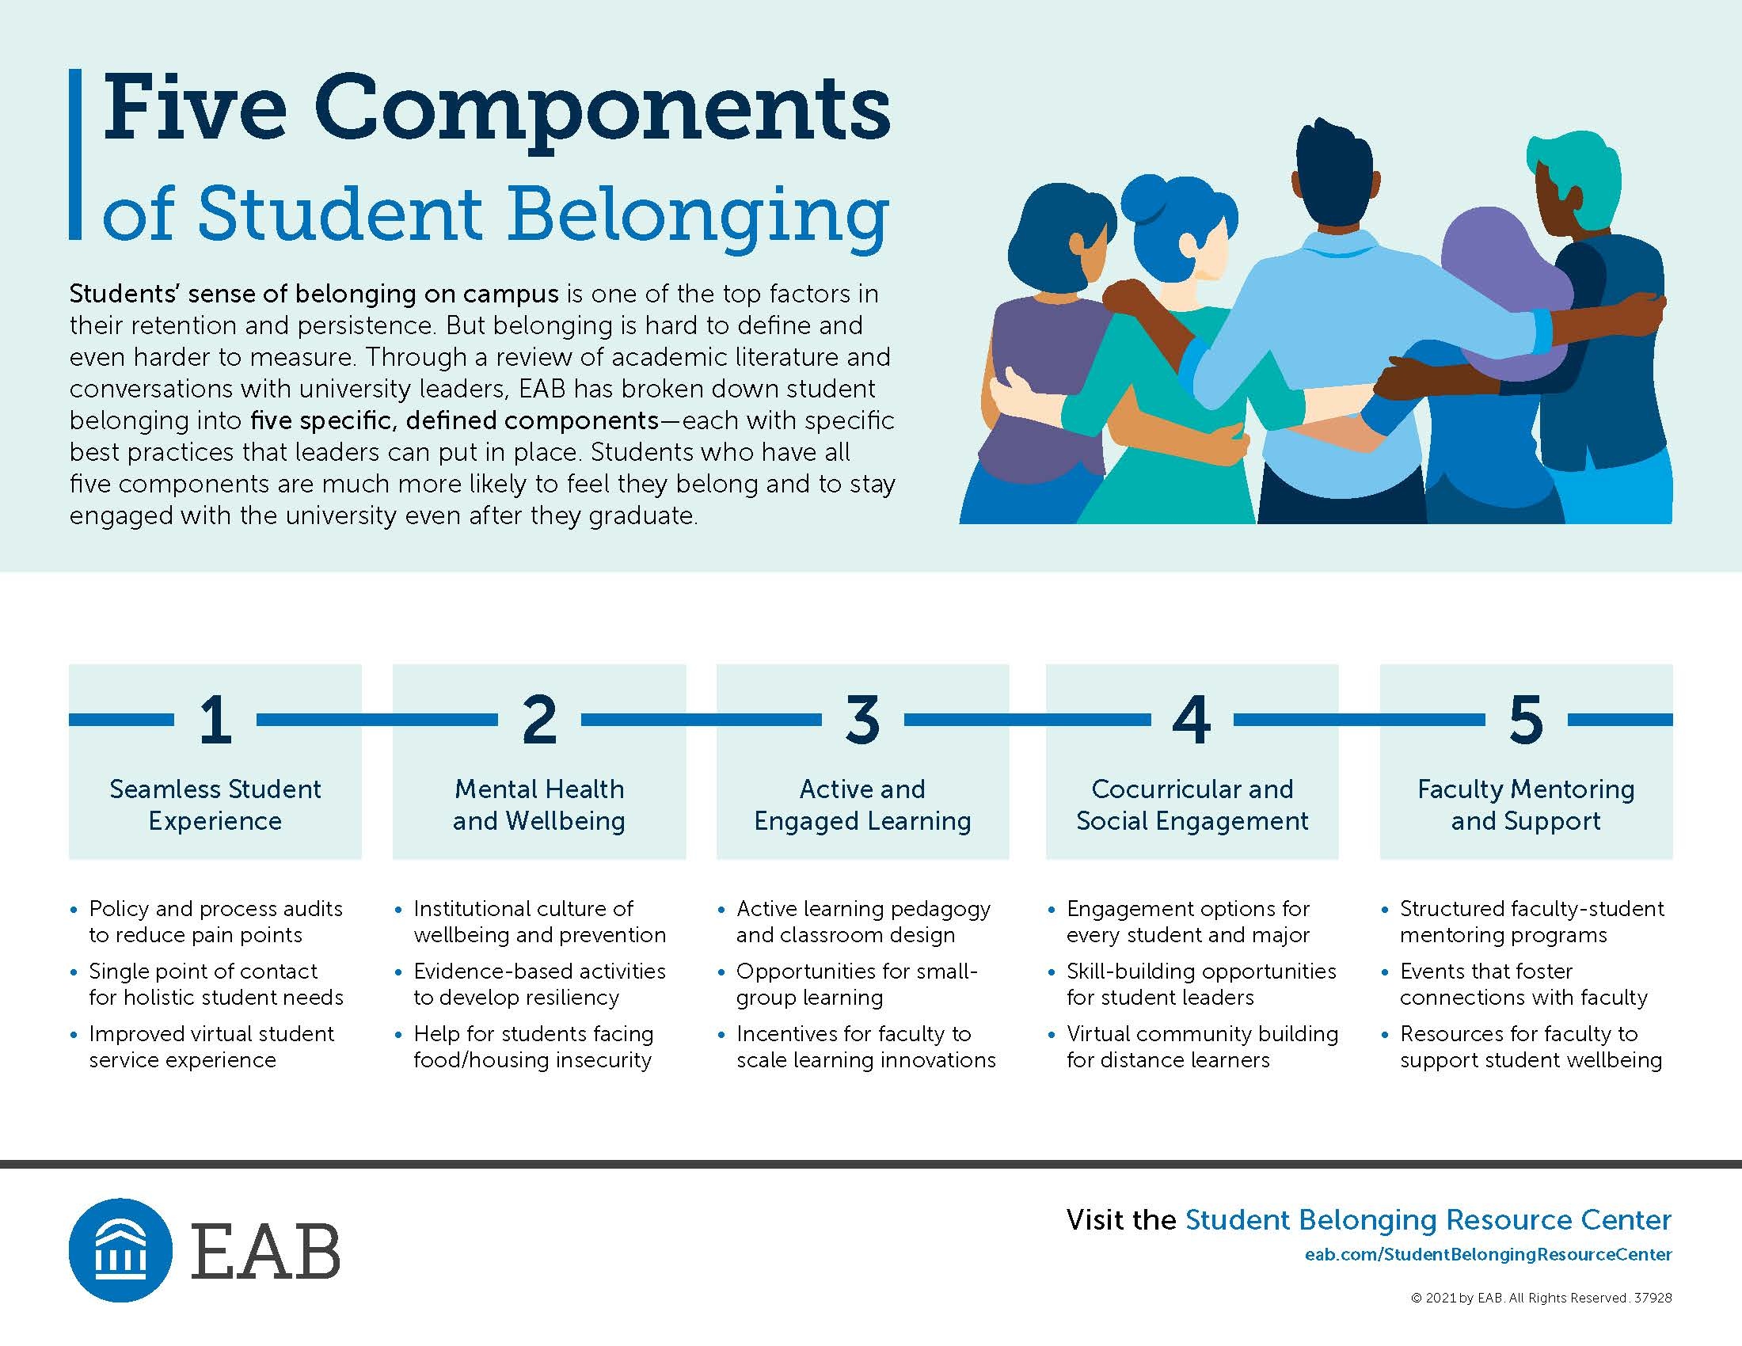
Notes:
DEVLYN: According to EAB, an Educational Consulting firm based in Washington DC, the answer is “yes!” They propose that there are five primary components that impact a student’s sense of “belonging” on a college campus. Notice that each of these components are linked to the intentional culture-creation by college faculty and administration, which means that it is our responsibility to make decisions that support a student’s sense of belonging.
Although this presentation will focus specifically on component #3 which is concerned with “Active and Engaged Learning,” it is important to recognize that there is dynamic interplay between each of these components! For example, the theory is that students that have positive experiences associated with components one through four will more easily transition to becoming an engaged alumni and mentor once they graduate. I can verify that this is possible, because the Counseling Programs are introducing a First-Year Student Mentorship Program, where incoming graduate students are paired with recently graduated alumni mentors who will act as a source of additional support and guidance for students beginning their clinical training!
Now, “active and engaged learning” sounds great in theory, but how do we practically (and actually) create this type of environment for our students?
Short answer? A Diversity, Equity, Inclusion and Belonging-informed curriculum – or DEI&B, for short.

Slide 6
Benefits of DEI&B-informed Curricula and Classrooms:
Increased connection to course content
Improved assessment and course outcomes
Addresses traditional instructional concerns
Invites students to contribute to the learning environment as a valued member of the community
Notes:
AMY: Current academic scholarship incorporates “belonging” into the existing DEI schema, with the expectation that when we foster a sense of belonging, this increases feelings of being supported and accepted – while also helping to potentially reduce problematic mental health and socioeconomic symptoms. Since belonging is the focus of our presentation, we needed to make sure to introduce it here!
DEI&B approaches to instruction in higher education are vital to improving students’ abilities to truly immerse themselves in all facets of the educational experience. Students have reported that classrooms that include a DEI&B approach feel more inclusive overall, which supports content mastery, improved problem solving, and novel implementation of skills and knowledge. DEI&B principles continue to push higher education to be more responsive to the student experience, which in turn improves learning outcomes, retention, and student involvement – before and after graduation.

Slide 7
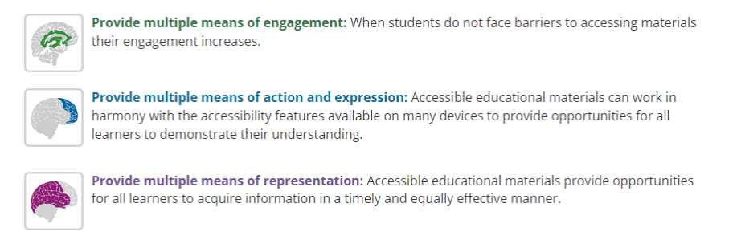
Benefits of DEI&B-informed Curricula and Classrooms:
Notes:
AMY: DEI&B-informed curricula and classrooms challenges educators to push beyond the “this is how I teach” mindset and asking “how do my students learn?” By providing multiple access points to the same material – and various ways to demonstrate mastery – more students have the opportunity to succeed and meaningfully engage both inside and outside of the classroom.

Slide 8
DEI&B-informed Curricula Includes:
Diversity in Content
Equity in Design
Inclusion in Teaching
Belonging in Practice
Notes:
DEVLYN: The key to understanding DEI&B theory is recognizing what questions need to be asked in order to broaden the scope of our understanding:
Diversity in Content – what voices are speaking in our classrooms? Whose stories do we tell?
Equity in Design – What learning outcomes are tied to the course? How many different ways can students meet those outcomes?
Inclusion in Teaching – How do we build inclusivity before the class begins? In the classroom? And outside of the classroom?
Belonging in Practice – How do we handle “hot moments” in the classroom? How do we respectfully support students in stressful times? And how do we foster a sense of belonging?

Slide 9
Diversity in Content:
Guiding Questions
What are the dominant narratives and perspectives in your field of study and courses?
How diverse are the textbooks and materials you use?
What can be done when diverse representation isn’t readily available in your discipline?
Practical Suggestions:
Consider providing articles from diverse perspectives to balance textbooks
Intentionally initiate classroom conversations regarding representation in the field
Create assignments that encourage students to research and engage alternative perspectives, resources, and professionals in the field
Notes:
DEVLYN: Because of time constraints, we won’t cover everything on the upcoming slides, but I will highlight a guiding question in each category and offer a few practical suggestions along the way. We have more practical suggestions available on the digital handouts, as well, so all of our content will be accessible and available moving forward!
Discuss bullets #2 and 3 in both questions and suggestions here.
QUESTION: What benefits would come from introducing these types of diversity-focused conversations into your specific classrooms, especially as it relates to your specific field of study and expertise?

Slide 10
Equity in Design:
Guiding Questions
What is required for students to be successful in your courses?
How do we support students that do not have access to these requirements?
How do I handle student accommodation requests?
Practical Suggestions:
Consider ways to reduce costs associated with your course (texts, technology, transportation, project materials, scheduling, and participation)
Develop a consistent process for reviewing student issues, not an inflexible response. An example of a consistent process would be:
  Consider student request
  Review any supporting documentation
  Consider essential elements of course, timing, and learning outcomes
Work with Accessibility Services to determine and provide accommodations
Consult best practices for Universal Classroom Design as you prepare your class
Notes:
DEVLYN: Remember, when we discuss equity, in DEI&B this is about equal access – not simply “treating everyone the same.”
One my favorite ways to reduce costs is this: If I assign a group project, make also intentionally schedule in-class time for groups to meet and work on those assignments. Not every student is available to meet outside of established class times due to other obligations and/or limitations.
Similarly, within the Counseling Programs, we have made adjustments to how the program is delivered, because it is not equitable from a financial standpoint to expect commuter students to show up on campus every single time a class is offered, especially when they are coming from an hour or more away.
Discuss “consistent process” v. “inflexible response.”
Class policy: NO LATE WORK ACCEPTED. (This is a self-protective move, because I want to set the expectation and alleviate the burden of having to accept late work and determine how many points to deduct.)
Class issue: A student doesn’t turn work in on time. Now what?
Follow the bullets! This still requires discernment, judgment, and clear communication, especially in regards to timing and course requirements! General rule: better to have a clear policy and exercise grace when it is warranted, versus needing a mechanism to address problematic behaviors or dispositions and not having anything in place!

Slide 11
Inclusion in Teaching:
Guiding Questions
How many different ways can students access you (the instructor)?
How many different way can students critically engage in the classroom?
Practical Suggestions:
Before: Clearly outline methods and opportunities for connection; set the tone with diverse curriculum, accessible materials, and inclusive syllabi statements; invite students to “tell their story” at the beginning of each course
During: develop classroom expectations; offer multiple ways to demonstrate mastery and learning; assign groups; respect names and pronouns
After: cultivate an “open door environment”; utilize empathic listening; embrace small talk; consider physical spaces
Notes:
DEVLYN: As a therapist, I am naturally inclined to make invitations for people to share their stories, and I try to make that same offer to my students in a number of different ways. Linking back to our opening conversation regarding “belonging” - making invitations to share and engage authentically within a safe space is an inclusive act – which can foster that sense of belonging we are aiming for.
Pick a few brief examples from before, during, and after to discuss.
Before: First thing I do in my classes: (1) ask for names and pronouns; (2) what are you excited about? ; and (3) what are you nervous about? (I usually couple this with a game of “tag” where students pick who responds next, because it forces them to pay closer attention to what has been said and who said it!)
During: construct classes to utilize multiple methods of demonstrating mastery, typically papers, exams, and presentations. Some can write, some can verbalize, some can memorize! Also, be careful not to weigh certain assignments or grades exponentially higher than others (i.e. papers are worth 60% of the total grade, while presentations are 10%). Consider utilizing ungraded assessments as low-stakes ways to help gauge learning along the way!
After: Is your office hospitable? Can students relax and be authentic in that space? Also – don’t dismiss “milk and cookies” talk – this is critical to forming trusting relationships!

Slide 12
Belonging in Practice:
Guiding Questions
How do we handle “hot moments” in the classroom?
How do we actively support students in stressful times?
How do we foster a sense of belonging?
Practical Suggestions for handling “hot moments”:
Manage your emotions and reactions
Promote “here and now” awareness of emotions
Utilize empathic listening
Encourage student reflection and active engagement
Don’t avoid the issue!
Have a fallback plan
Notes:
AMY: For the sake of time, I will simply say that people will act in ways that we will never understand without first understanding their background so when a student acts in a way that does not make sense to you please do not react in a judgmental way. Simple ask what they need at that time or how you can help. Feel free to walk them over to Counseling Services! I would be remiss if I did not promote a lunch-n-learn that Laura Rich and I have done in the past and plan to host again this semester entitled “Working with a Difficult Students” which addresses all of these bullet points. You can learn more by following us on Instagram at Campbell Counseling.

Slide 13
Belonging in Practice II:
Practical Suggestions for supporting students in stressful times:
Notice, Ask, Refer
Be honest and encouraging, rather than reassuring
Encourage tolerance and active engagement of anxiety, not avoidance
Model good coping behaviors for students
Take care of yourself and know your limits!
Notes:
AMY: Please keep in mind that how your respond to a student will determine if they will continue to reach out for help or shut down. All of these are great suggestions. Counseling Services is always here for a consultation if you are interested. We invite you to check out our efforts on campus and encourage your students to attend our events and write a paper about what they learned for extra credit. We have groups, therapist in the halls, Let’s Talk, Connect and Chat, and so much more.

Slide 14
Belonging in Practice III:
Practical Suggestions for fostering a sense of belonging:
Address unconscious bias
  Understood here as underlying attitudes and stereotypes
  Impacts how we understand and engage with others (colleagues and students)
Recognize and respond to microaggressions
  Defined as indirect, subtle, or unintentional discrimination against members of a marginalized group
  Although possibly done without any conscious intent to injure or malice, the impact is felt in a negative way
  5 General Tips on how to respond:
    Remain calm and notice your breathing
    Give people the benefit of the doubt
    Focus on the statement or action, not the person
    Be clear why the microaggression is a problem
    Develop your own method for responding to microaggressions
Notes:
AMY: As a faculty member, you are in a position of authority. You can use that responsibility to promote well-being. For example, you can be aware of and avoid microaggressions. You can also respond to microaggressions and help create a safer environment of belonging. Some examples of microaggressions are:
Statement: “You can succeed if you try hard enough.” Message: You are lazy.
Statement: “You throw like a girl.” Message: Feminine qualities are bad.
Statement: “Being gay is just a phase.” Message: Your identity is invalid.
Statement: “You are a credit to your race.” Message: People of your background are unsuccessful.

Slide 15
Belonging in Practice IV:
Practical Suggestions for fostering a sense of belonging:
Be an ally by:
  Knowing your privilege and use it to help marginalized groups
  Listen to diverse groups and educate yourself
  Advocate for diverse groups – do not speak over them!
  Apologize when you make mistakes (consider impact over intent)
  Being an ally is about action!
Notes:
AMY: Helps us to fight the stigma of mental health and to promote help seeking behaviors. Research suggests that a person is more likely to get help if it is suggested by a person they know. Counseling Services is here, and we take walk-ins!

Slide 16
Notes:
DEVLYN: Discuss new Counseling Programs mission statement / poster.

Slide 17

Notes:
AMY: Pitch for Counseling Services

Slide 18
Questions? Discussion? Collaboration?
Amy Johnson - amjohnson@campbell.edu
Devlyn McCreight - dmccreight@campbell.edu

Slide 19


